Slide 1
Classic Blockchain Consensus
Risman Adnan Mattotorang, Ph.D
Telkom University

Slide 2
What You Learnt Last Week
The Mechanics of Bitcoin Transactions
Overview of Consensus Layer
Bitcoin’s Blockchain
Bitcoin’s Transactions
Bitcoin’s Script
Managing Crypto Assets (Wallet)

Slide 3
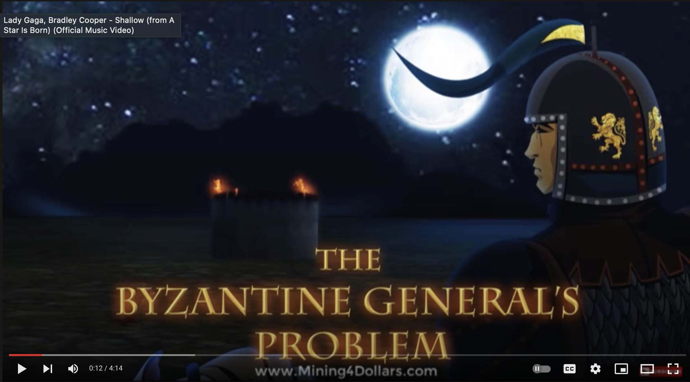
What You Will Learn Today
Classic Blockchain Consensus
Byzantine General Problem
Byzantine Fault Tolerant Protocol (BFT)
Blockchain from Byzantine Consensus
Some Examples
https://www.youtube.com/watch?v=dfsRQyYXOsQ

Slide 4


Blockchain Forks
TX_{A}: Send 3 BTC to Bob
TX_{A}
…
TX_{A}: Send 3 BTC to herself
TX_{A}

Slide 5
Double Spending
Alice can create two transactions spending the same UTXO!
One sends money to Bob, the other sends the UTXO to herself.
Only the ‘first’ transaction should go through
-> There needs to be a global consensus on the ordering of transactions.
Concretely, there needs to be an agreement which block extends the blockchain (Fork Choice Problem)

Slide 6

Block choice
New Block
Reject?
Accept
Block A
Reject
404

Slide 7
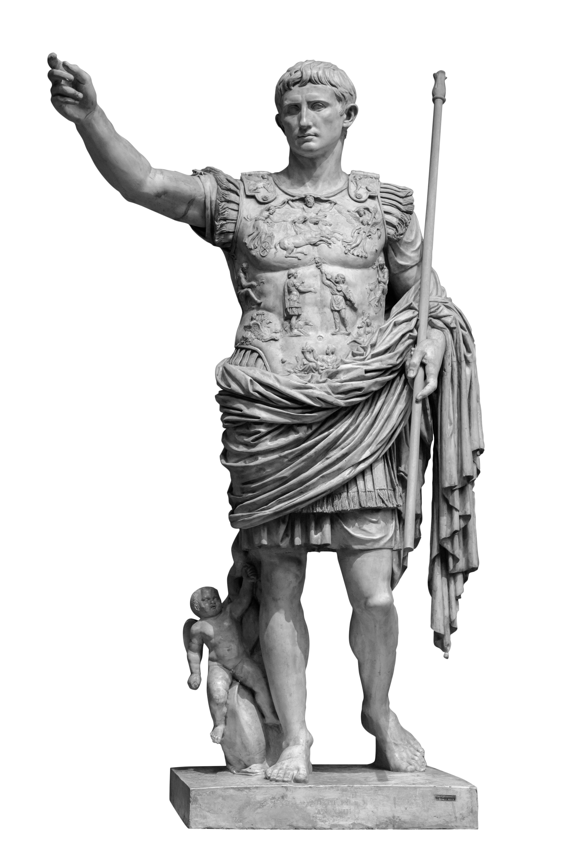
Byzantine Generals Problem
Block choice is equivalent to BGP
New Block
Attack
Reject?
Accept
Retreat?
Attack
Block A
Reject
404
Retreat
404

Slide 8
Byzantine Generals Problem
Leader gets an input bit 0/1
Every round each node sends messages to every other general. Messages are received in the next round
At the end of the protocol honest nodes output a bit or abort
Attack
Attack
Notes:
A round in the real world can be some fixed time in which all participants will be able to send their messages

Slide 9
Byzantine Generals Problem
Honest generals follow the protocol.
Malicious generals behave arbitrarily
Assuming signatures

Slide 10
Byzantine Fault Tolerant Protocol (BFT)
Consistency
If two honest nodes output b and b’′ respectively, then ′
b=b’.
Validity
If the leader is honest and receives input b then all honest nodes output b
Notes:
Each trivial on their own

Slide 11
Voting Protocol
Leader sends b to all nodes
All nodes forward received bit to all other nodes (Voting)
Each node tallies votes (including its own vote) and outputs majority bit
Broken by corrupt leader

Slide 12
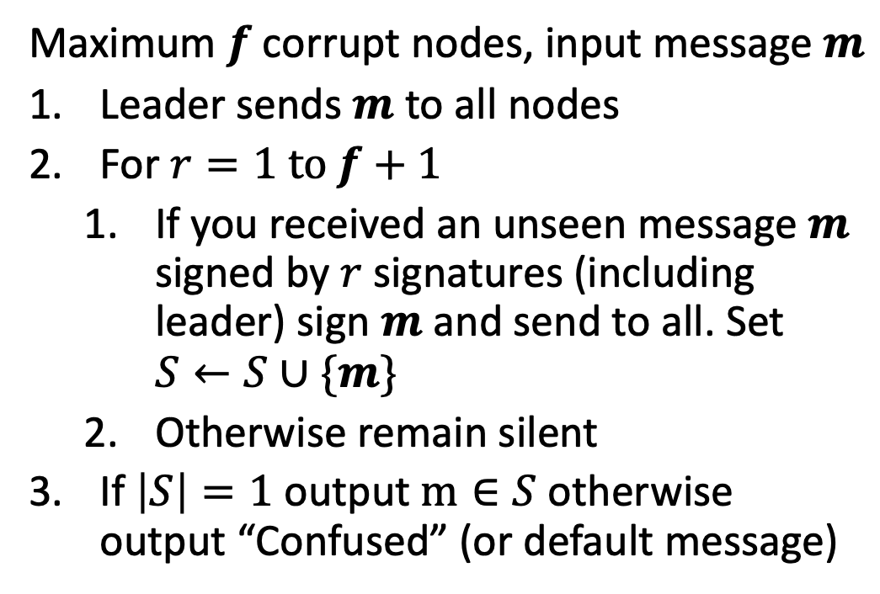
Dolev Strong Protocol
Maximum $f$ corrupt nodes, input message $m$
Leader sends $m$ to all nodes
For $r=1 to f+1$
If you received an unseen message $m$ signed by $r$ signatures (including leader) sign $m$ and send to all. Set $S←S∪\{m\}$
Otherwise remain silent
If $\left|S\right|=1$ output $m∈S$ otherwise output “Confused” (or default message)
f+1 rounds too slow for practice

Slide 13
Dolev Strong Example
Attack=1
f=2
1_{Caesar}
1_{Caesar}
1_{Caesar}
1_{Caesar}
Brutus
Marc Anthony
Pompeius
Augustus

Slide 14
Dolev Strong Example
Attack=1
f=2
r=1
1_{Caesar,MA}
1_{Caesar,MA}
1_{Caesar,MA}
1_{Caesar,MA}
Brutus
Marc Anthony
1_{Caesar, Aug}
1_{Caesar, Aug}
1_{Caesar, Aug}
1_{Caesar, Aug}
Pompeius
Augustus

Slide 15
Dolev Strong Example
Attack=1
f=2
r=2
1_{Caesar,Aug, MA}
Brutus
Marc Anthony
0_{Brutus,Pompeius}
1_{Caesar, MA,Aug}
Pompeius
Augustus

Slide 16
Dolev Strong Example
Attack=1
f=2
r=3
1_{Caesar,Aug, MA}
Brutus
Marc Anthony
1_{Caesar, MA,Aug}
Pompeius
Augustus

Slide 17
Dolev Strong Example
Attack=1
f=2
r=3
Attack
1_{Caesar,Aug, MA}
Brutus
Marc Anthony
Attack
1_{Caesar, MA,Aug}
Pompeius
Augustus

Slide 18
More than f corruptions
f=2
r=3
1_{Caesar,Aug, MA}
Brutus
Marc Anthony
0_{Caesar,Brutus,Pompeius}
1_{Caesar, MA,Aug}
Pompeius
Augustus

Slide 19
More than f corruptions
f=2
r=3
Confused
0_{Caesar,Brutus,Pompeius}
1_{Caesar,Aug, MA}
Brutus
Attack
Marc Anthony
1_{Caesar, MA,Aug}
Pompeius
Augustus

Slide 20
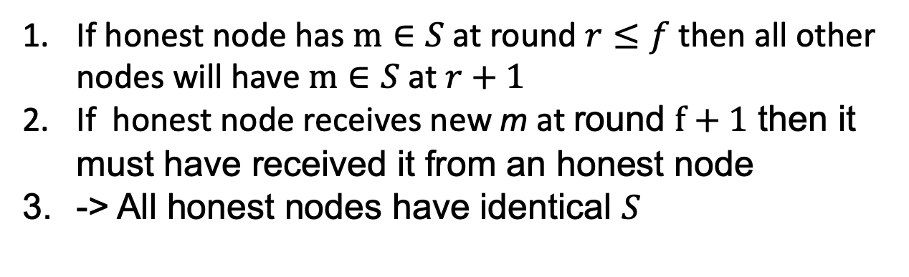

Dolev Strong Analysis
Why f+1 rounds?
f corrupt nodes can confuse honest node
Validity?
Honest nodes only update set $S$ if signed by leader
Consistency?
If honest node has $m∈S$ at round $r≤f$ then all other nodes will have $m∈S$ at $r+1$
If honest node receives new m at round $f+1$ then it must have received it from an honest node
-> All honest nodes have identical $S$

Slide 21
From Byzantine Consensus to Blockchains
…
In a blockchain we solve a Byzantine General’s Problem for every block.
This is called an iterated BGP
Notes:
Fixed nodes agree on single message vs ledger of transactions. Arbitrary nodes can join/leave

Slide 22
Sybil Resistance
In BC participants are fixed but how are they selected?
Two variants:
Permissioned: Nodes are fixed
Permissionless: Anyone can participate

Slide 23






Permissioned Consensus

Slide 24

Proof of Stake
Weighted Byzantine Consensus
Super large consensus
3 ETH
1 ETH
7 ETH
2 ETH
How to initialize? Incentives?
More in 2 lectures
Assumption 2/3rd of stake with honest nodes
5 ETH

Slide 25

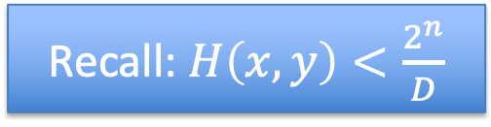
Permissionless Proof of Work
Recall: $H\left(x,y\right)<\frac{2^{n}}{D}$
Truly permissionless
3 TH/s
5 TH/s
7 TH/s
2 TH/s
Terrible for the environment
More next lecture
5 TH/s

Slide 26
Network Model
Dolev Strong assumes messages gets delivered by next round
Not realistic (honest nodes can have network outages)
Protocol broken if messages aren’t delivered in time

Slide 27
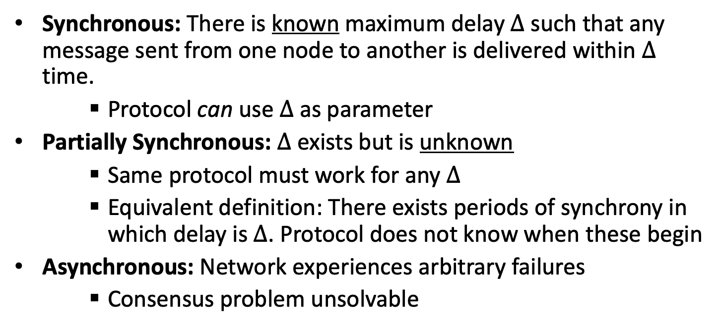

Network Model
Synchronous: There is known maximum delay $Δ$ such that any message sent from one node to another is delivered within $Δ$ time.
Protocol can use $Δ$ as parameter
Partially Synchronous: $Δ$ exists but is unknown
Same protocol must work for any $Δ$
Equivalent definition: There exists periods of synchrony in which delay is $Δ$. Protocol does not know when these begin
Asynchronous: Network experiences arbitrary failures
Consensus problem unsolvable
Any f (Dolev-Strong)
$$f<n/3$$
Notes:
D-S
1/3 lower bound

Slide 28
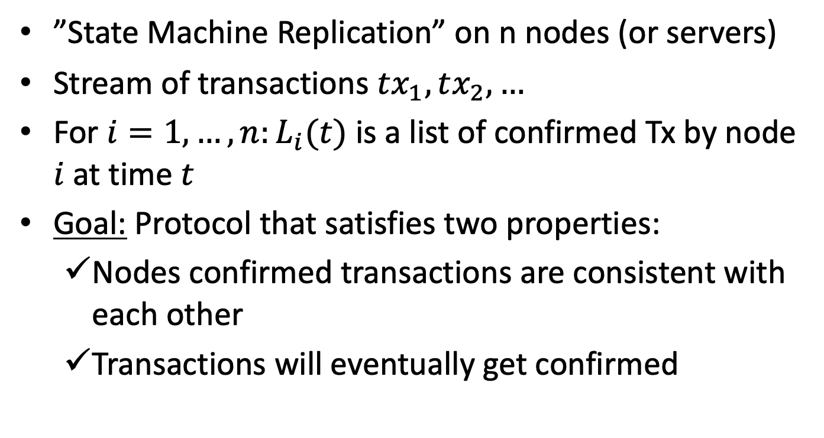
Blockchain Consensus
”State Machine Replication” on n nodes (or servers)
Stream of transactions $tx_{1},tx_{2},…$
For $i=1,…,n:L_{i}(t)$ is a list of confirmed Tx by node $i$ at time $t$
Goal: Protocol that satisfies two properties:
Nodes confirmed transactions are consistent with each other
Transactions will eventually get confirmed
Notes:
Note that accepting/rejecting transactions is done at a different layer (the blockchain computer)

Slide 29
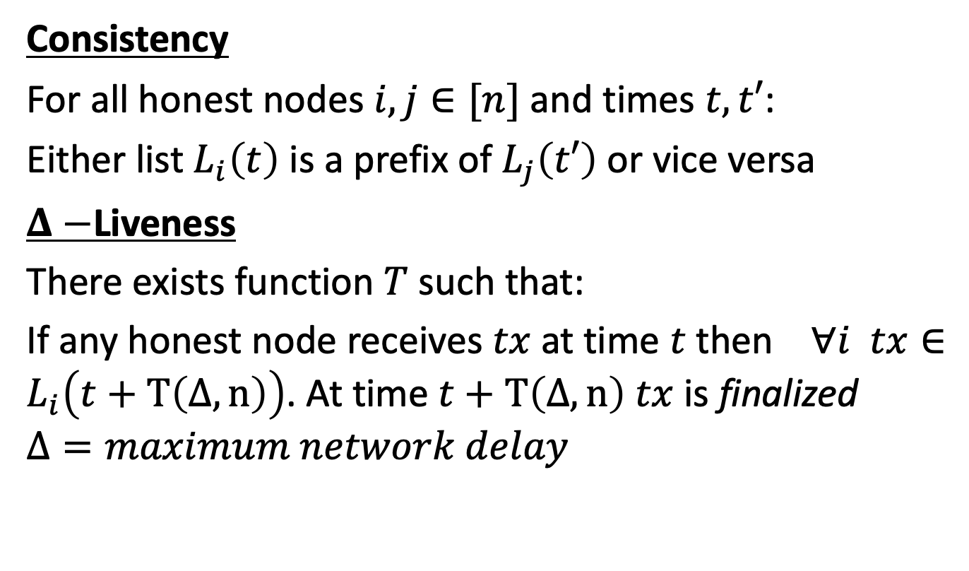
Blockchain Consensus
Consistency
For all honest nodes $i,j∈[n]$ and times $t,t′$:
Either list $L_{i}\left(t\right)$ is a prefix of $L_{j}\left(t′\right)$ or vice versa
$Δ−$Liveness
There exists function $T$ such that:
If any honest node receives $tx$ at time $t$ then $∀i tx∈L_{i}\left(t+T\left(Δ,n\right)\right)$. At time $t+T\left(Δ,n\right)$ $tx$ is finalized
$$Δ=maximum network delay$$

Slide 30
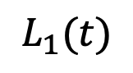
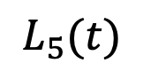
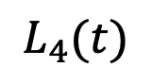
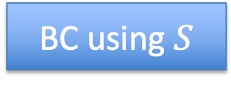
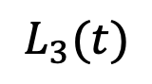
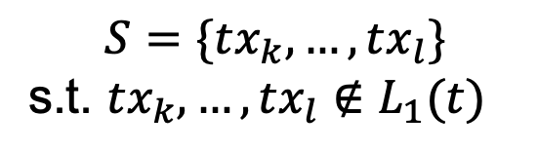
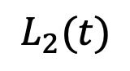
Blockchain from Byzantine Consensus
Epoch t
$$L_{2}(t)$$
$$L_{1}(t)$$
$$S=\{tx_{k},…,tx_{l}\}$$
s.t. $tx_{k},…,tx_{l}∉L_{1}(t)$
BC using $S$
$$L_{3}(t)$$
$$L_{5}(t)$$
$$L_{4}(t)$$
”S” is a new block

Slide 31
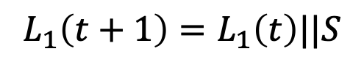
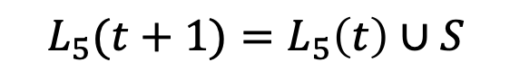
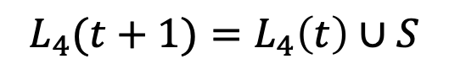
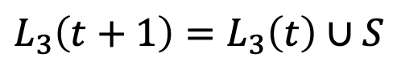
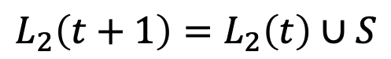
Blockchain from Byzantine Consensus
Epoch t+1
$$L_{2}\left(t+1\right)=L_{2}\left(t\right)∪S$$
$$L_{1}\left(t+1\right)=L_{1}\left(t\right)||S$$
BC using $S$
$$L_{5}(t+1)=L_{5}\left(t\right)∪S$$
$$L_{3}\left(t+1\right)=L_{3}\left(t\right)∪S$$
$$L_{4}(t+1)=L_{4}\left(t\right)∪S$$

Slide 32
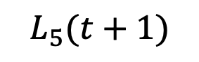
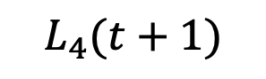
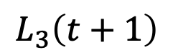
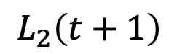

Blockchain from Byzantine Consensus
Rotating leader
Epoch t+1
$$L_{2}\left(t+1\right)$$
$$L_{1}\left(t+1\right)$$
$$L_{5}(t+1)$$
$$L_{3}\left(t+1\right)$$
Dolev Strong can take f+1 rounds
Dolev Strong is synchronous
Can we built something better?
$$L_{4}(t+1)$$
Notes:
IF BC takes R rounds then O(n*R)

Slide 33


Streamlet: A simple Blockchain protocol
Assumptions:
n nodes (permissioned)
Less than 1/3 corrupt
Partially synchronous network
Proceed in epochs
Random rotating leader:
Leader id= H(epoch) mod n
2
$$⊥$$
$$⊥$$
2
1
Each node stores locally notarized chain

Slide 34
Streamlet [Chan,Shi20]
Propose Vote In every epoch:
Leader creates block of TXs extending longest local notarized chain
Nodes sign off on first block from leader iff it extends one of their longest local notarized chain
If any Block has signatures from 2n/3 nodes it becomes notarized (Can be from a prior epoch)
Finalize
If a chain has 3 notarized blocks from consecutive epochs, chop off the final block and finalize the chain

Slide 35

Streamlet: A simple Blockchain protocol
Assumptions:
Less than 1/3 corrupt
Partially synchronous network
Proceed in epochs
Random rotating leader:
Leader id= H(epoch) mod n
2
$$⊥$$
$$⊥$$
2
5
5
1
Each node stores locally notarized chain

Slide 36
Streamlet: A simple Blockchain protocol
Assumptions:
Less than 1/3 corrupt
Partially synchronous network
Proceed in epochs
Random rotating leader:
Leader id= H(epoch) mod n
Reject 3
2
5
$$⊥$$
$$⊥$$
2
5
1
3
Sign off on 5
Sign off on 3
Each node stores locally notarized chain

Slide 37
Streamlet: A simple Blockchain protocol
Assumptions:
Less than 1/3 corrupt
Partially synchronous network
Proceed in epochs
Random rotating leader:
Leader id= H(epoch) mod n
2n/3 sigs. -> notarized
2
5
6
$$⊥$$
1
3
Each node stores locally notarized chain

Slide 38
Streamlet: A simple Blockchain protocol
Assumptions:
Less than 1/3 corrupt
Partially synchronous network
Proceed in epochs
Random rotating leader:
Leader id= H(epoch) mod n
2
5
6
7
$$⊥$$
1
3
Each node stores locally notarized chain

Slide 39

Streamlet: A simple Blockchain protocol
Assumptions:
Less than 1/3 corrupt
Partially synchronous network
Proceed in epochs
Random rotating leader:
Leader id= H(epoch) mod n
2
5
6
7
$$⊥$$
No other block on level 6 can be notarized
1
3
X
Each node stores locally notarized chain

Slide 40

Streamlet: Consistency Analysis
No two blocks with same epoch can be notarized (2/3 majority)
If X<5 then more than 1/3 honest nodes voted on 3. These nodes would never notarize 5 (because 5 doesn’t extend 3). Without these 1/3+1 nodes 5 can’t get notarized (Contradiction)
If X>7 more than 1/3 honest nodes have notarized 6. They won’t notarize X because it doesn’t extend 6
2
5
6
7
$$⊥$$
No other block on level 6 can be notarized.
Consistency holds irrespective of network
1
3
X

Slide 41
Ethereum Consensus
Consensus is not directly related to building a Dapp.
Ethereum uses a Proof of Work consensus protocol.
Block Creation: POW is done by miners, who compete to create new blocks full of processed transactions. The winner shares the new block with the rest of the network and earns some freshly minted ETH. The race is won by whosever computer can solve a math puzzle fastest – this produces the cryptographic link between the current block and the block that went before. Solving this puzzle is the work in "proof-of-work".
Security: The network is kept secure by the fact that you'd need 51% of the network's computing power to defraud the chain. This would require such huge investments in equipment and energy; you're likely to spend more than you'd gain.

Slide 42
Ethereum Consensus
Ethereum plans to upgrade to a proof-of-stake (PoS) consensus:
Block Creation: POS is done by validators who have staked ETH to participate in the system. A validator is chosen at random to create new blocks, share them with the network and earn rewards. Instead of needing to do intense computational work, you simply need to have staked your ETH in the network. This is what incentivises healthy network behaviour.
Security: A proof-of-stake system is kept secure by the fact that you'd need 51% of the total staked ETH to defraud the chain. And that your stake is slashed for malicious behaviour.
Notes:
Proof-of-stake is done by validators who have staked ETH to participate in the system. A validator is chosen at random to create new blocks, share them with the network and earn rewards. Instead of needing to do intense computational work, you simply need to have staked your ETH in the network. This is what incentivises healthy network behaviour.

Slide 43
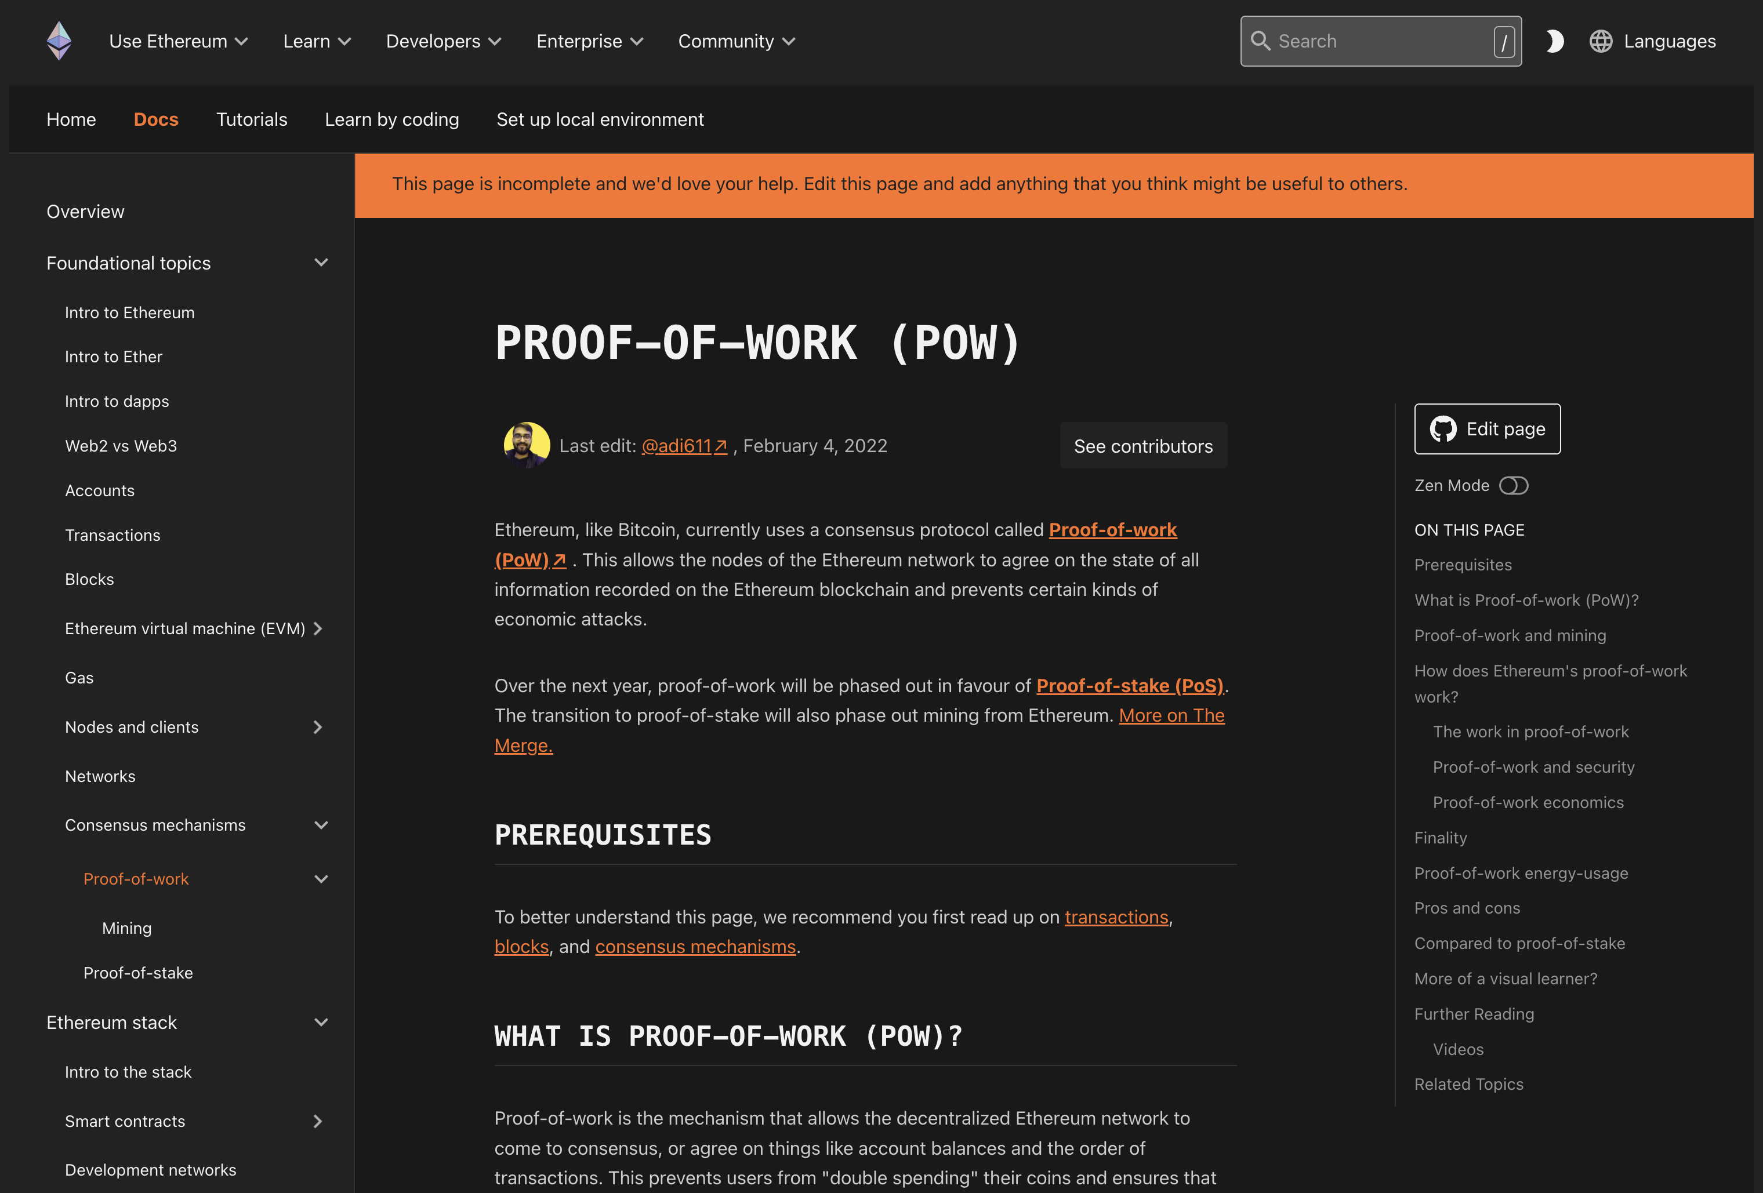
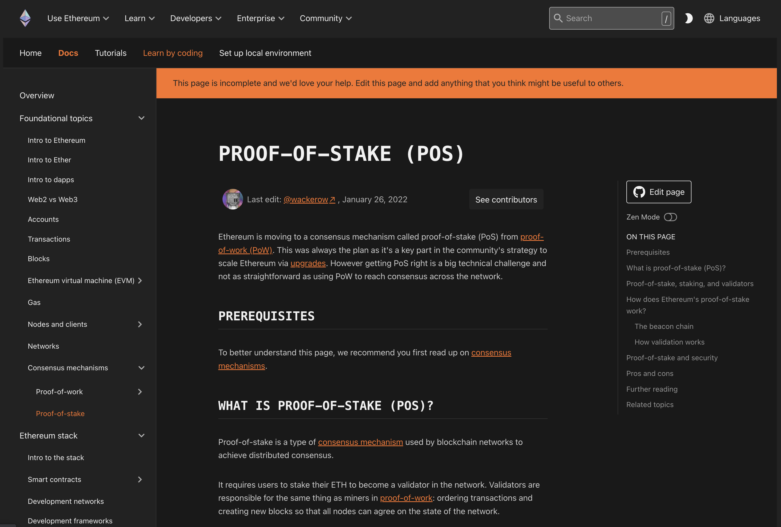
Week 4 Home Work
Learn more about Ethereum POW and POS

Slide 44

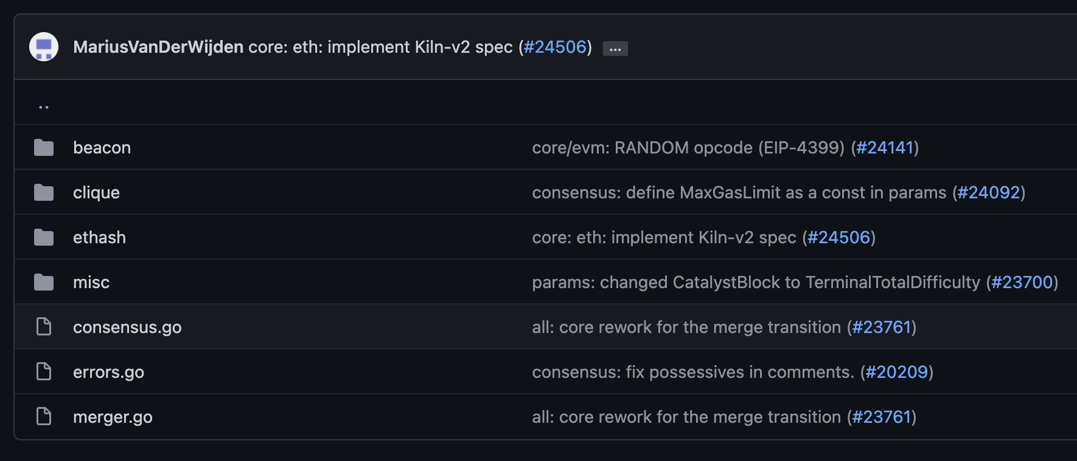
Week 4 Home Work
Hack Go Ethereum Consensus Codes
Install from sources and evaluate Consensus codes

Slide 45
END OF LECTURE
Next lecture: Nakamoto and Large Scale Consensus

